Slide 1
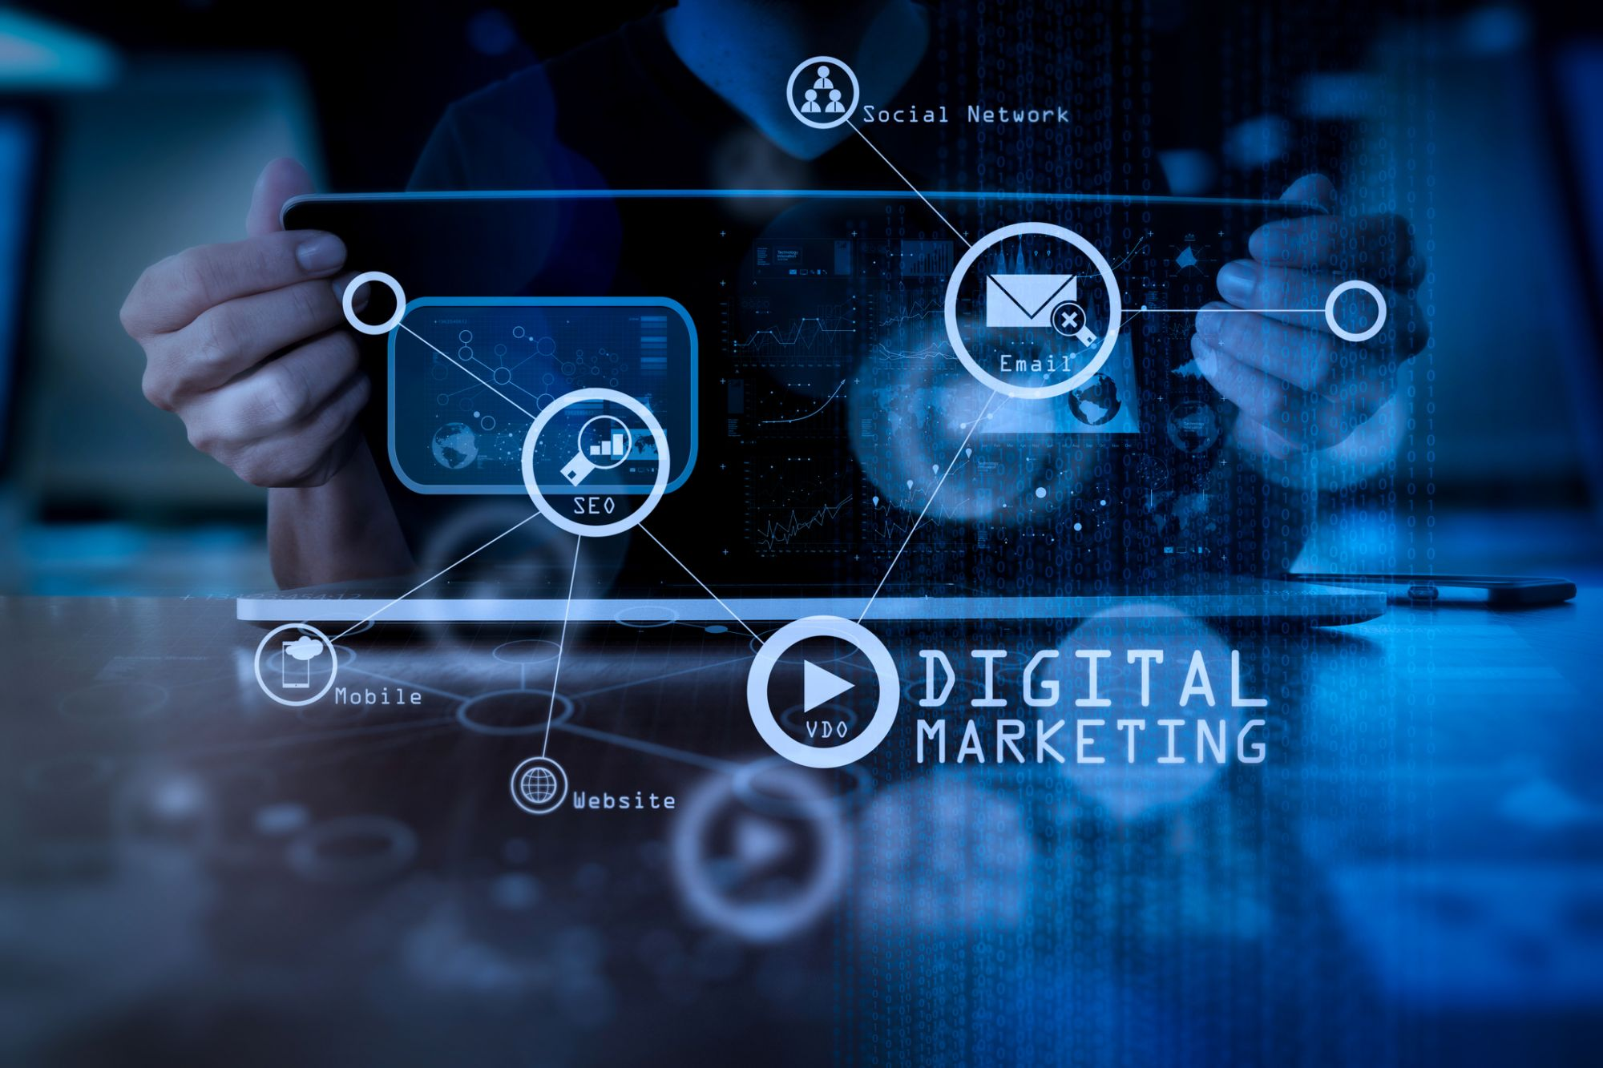

Slide 2

Intro to Digital Marketing

Slide 3
Digital marketing refers to the use of digital channels and technologies to promote products and services. This includes various online platforms such as websites, social media, email, and search engines
Definition
Importance
Increasing Online Presence
Establishes a brand’s visibility in the digital space
Targeting Specific Audiences Effectively
Utilizes data analytics to reach desired demographics
Measurable Results
Provides insights through analytics, allowing businesses to track the effectiveness of campaigns

Slide 4
Channels
Evolution of Marketing
Traditional Marketing
Digital Marketing
Channels
Print ads
Websites
Television commercials
Social media platforms
Radio spots
Email campaigns
Limitations
Advantages
Limited targeting
Greater reach
Often lacks measurable results
Targeting capabilities
Real-time feedback
Statistics
According to recent studies, over 70% of consumers rely on online sources for product information before making a purchase

Slide 5
Key Benefits of Digital Marketing
Cost-Effectiveness
Digital marketing often incurs lower costs than traditional marketing, allowing even small businesses to compete effectively
Global reach
Businesses can target customers around the globe, breaking geographical barriers
Targeted Marketing
Leveraging data allows marketers to create campaigns tailored to specific demographics, improving conversion rates
Real-time Results
Instant feedback through analytics tools helps businesses adjust strategies swiftly for better performance

Slide 6
Core Components of Digital Marketing
SEO (Search Engine Optimization)
Enhances website visibility in search engine results, improving organic traffic
SEM (Search Engine Marketing)
Involves paid advertising strategies like PPC (pay-per-click) to drive traffic
Social Media Marketing
Utilizes platforms like Facebook, Instagram, and Twitter to engage audiences and promote content
Email Marketing
Involves direct communication with potential customers through targeted email campaigns
Content Marketing
Focuses on creating valuable content (blogs, videos, infographics) to attract and retain audiences

Slide 7
Real-World Examples of Digital Marketing
Example 1
Nike
Utilizes social media campaigns effectively, such as the #JustDoIt campaign, encouraging user engagement and brand loyalty
Example 2
Amazon
Implements personalized email marketing strategies that suggest products based on user behavior, increasing conversion rates
Example 3
Airbnb
Employs a strong SEO strategy focusing on travel-related keywords, enhancing their online visibility and attracting more customers

Slide 8
Case Study: Successful Digital Marketing Campaign
Campaign
Coca-Cola's "Share a Coke"
Objective
Increase brand engagement and boost sales.
Strategies used
Engaged users through social media interaction
Encouraged user-generated content by inviting customers to share photos with personalized Coke bottles
Results
Increased Sales
Reported a 2% increase in sales in the US during the campaign period
Engagement Metrics
Millions of social media interactions, with a significant increase in brand mentions

Slide 9
Discussion Questions
What aspects of digital marketing do you find most appealing?
(Encourage students to share their thoughts on specific strategies or channels)
Can you think of a brand whose digital marketing you admire? Why?
(Prompt students to discuss effective brands and what they do well)

Slide 10


Slide 11


